Slide 2
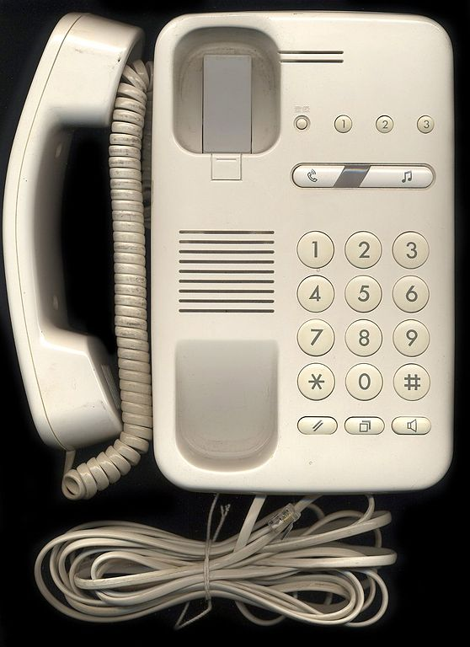

Slide 6
NATURAL NUMBERS: Numbers which starts from 1. Such as 1,2,3,4,5.....the natural numbers are
WHOLE NUMBERS: Natural numbers including 0. Such as 0,1,2,3,4,5..…...…....

Slide 8
Notes:
Hello hello my name is status the

